Slide 1

Spam Classification in Theory of Computation
By
PVL Sandhya Madhuri(192211093)
M .Hemasri(192210534)

Slide 2

Understanding Spam
Concept of Spam
Spam refers to unsolicited and often malicious or irrelevant messages sent over digital communication channels, such as emails, social media, or messaging platforms. It can include advertisements, scams, and phishing attempts, leading to a negative impact on user experience and security.
Impact on Digital Communication
Spam disrupts the flow of legitimate communication and can decrease productivity. It also poses cybersecurity risks, as recipients may inadvertently engage with harmful content, leading to data breaches, financial loss, or identity theft.
Regulatory Measures
Various laws and regulations, such as the CAN-SPAM Act in the US and the General Data Protection Regulation (GDPR) in the EU, have been implemented to curb spam and protect individuals' privacy and digital rights.
Photos provided by Pexels

Slide 3
Theory of Computation
Automata and Languages
Fundamentals
Relevance to Spam Classification
Automata theory and formal languages, integral components of computation theory, provide frameworks for understanding patterns in textual data, thereby enabling the identification of spam characteristics and patterns in electronic communications.
Theory of computation encompasses the study of algorithms, computational complexity, and formal languages. It provides fundamental models to analyze computational problems, complexities, and the capabilities and limitations of computational devices.
In the context of spam classification, theory of computation offers insights into the development and analysis of algorithms for distinguishing spam from legitimate messages. It aids in designing efficient and accurate classification techniques, contributing to the enhancement of spam filtering systems.

Slide 4
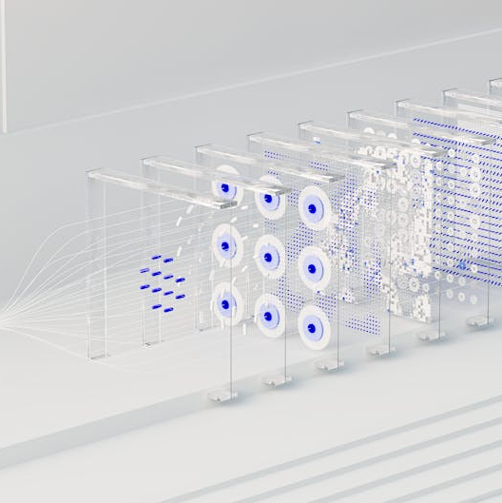
Spam Classification Techniques
Machine Learning Algorithms
Machine learning techniques, such as Naive Bayes, Support Vector Machines (SVM), and neural networks, are employed for spam classification. These algorithms utilize features extracted from email content and metadata to differentiate between spam and legitimate messages.
Keyword Analysis
Spam classification methods involve analyzing the presence of specific keywords, phrases, or patterns associated with spam content. This approach helps in identifying common spam indicators and adapting filtering strategies accordingly.
Behavioral Analysis
By observing user interaction patterns and email behaviors, spam filtering systems can adapt and refine their classification rules, improving their ability to distinguish between spam and non-spam messages.
Photos provided by Pexels

Slide 5

Challenges in Spam Classification
Evolving Spam Tactics
False Positives and Negatives
Spammers continuously evolve their tactics, making it challenging to create robust and adaptable spam filters. This necessitates constant updates to spam classification techniques to effectively counter new spamming strategies.
Balancing the reduction of false positives (misclassifying legitimate messages as spam) and false negatives (allowing spam messages to pass through) remains a significant challenge, as it directly impacts user experience and trust in email communication.
Multilingual and Contextual Analysis
Safeguarding diverse users across multiple languages and cultural contexts presents complexities in accurately identifying spam, as linguistic nuances and cultural differences influence the interpretation of spam content and intent.

Slide 6

Application of Theory of Computation in Spam Filtering
Algorithmic Optimization
Applying computational theory principles enables the optimization of spam filtering algorithms, leading to improved accuracy and efficiency in identifying and flagging spam content, thereby enhancing email security.
Computational Complexity Analysis
Theoretical frameworks aid in assessing the computational complexity of spam classification algorithms, guiding the development of scalable and resource-efficient filtering systems capable of handling large-scale email traffic.
Automated Learning and Adaptation
Leveraging computational models facilitates the automated learning and adaptation of spam filtering systems, allowing them to dynamically adjust to evolving spam tactics and user behaviors in real-time.
Photos provided by Pexels

Slide 7
Conclusion and Future Implications
Ethical and Privacy Considerations
Key Takeaways
Future Developments
As technological advancements shape spam classification methods, ethical considerations on user privacy, consent, and data protection must be upheld to maintain trust and integrity in digital communications and security practices.
The integration of theory of computation in spam classification has advanced the development of robust and adaptive filtering techniques, contributing to the mitigation of spam-related threats in digital communication ecosystems.
Continued research and innovation in spam classification leveraging computational theory are poised to address emerging challenges, including improved multilingual classification, context-aware analysis, and increased resilience against evolving spam tactics.

